Slide 1
Communication Technology Classroom Safety
The do’s and don'ts of the classroom

Slide 2

What is WHMIS
Workplace Hazardous Materials Information System
Canada's national hazard communication standard. The key elements of the system are hazard classification, cautionary labelling of containers, the provision of (material) safety data sheets ((M)SDSs) and worker education and training programs.
The basis for hazard classification and communication in WHMIS is changing. With the incorporation of the Globally Harmonized System of Classification and Labelling for chemicals (GHS) in WHMIS, the hazard classification and communication requirements of WHMIS have been aligned with those used in the United States and other Canadian trading partners.

Slide 3

Classroom Safety
No Horse play
Like any other classroom setting there will be no horseplay. We are all dealing with expensive equipment and an environment where accident can happen.

Slide 4

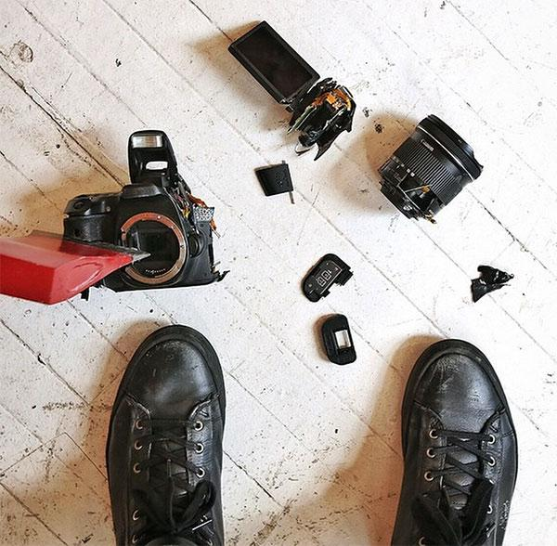
Equipment safety
We are working with a variety of expensive equipment such as computers, cameras, projectors, and other communication technology tools. You are responsible for all equipment that you are using and if you do not take good care of the equipment it is then your responsibility to replace it. You break it you bought it.

Slide 5
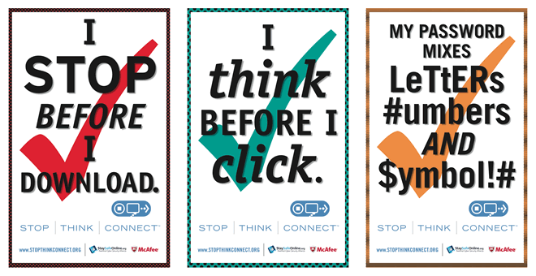


Internet Safety
We will be doing a lot of online work. Be aware, that many of your work can or will be visible to the work via the internet. Please have consideration when posting any type of information. You will never be required to give your password to anyone or any site so aware of who or where you are lending your information too. You will also have to make sure when extracting information from the internet you will have to keep copyright terms in mind.

Slide 6
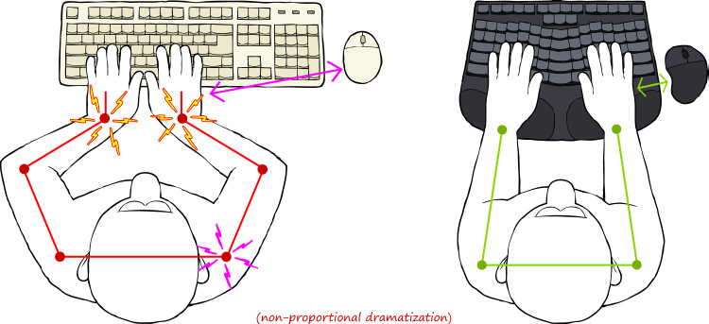
Ergonomics
Ergonomics is the science of matching the job to the worker and the product to the user. This section covers situations such as lifting, lighting, office/desk set up, etc. that may contribute to injury.
This section also includes information on health and safety concerns when working shiftwork and extended work days.

Slide 7
Lighting
Whether in industrial or office settings, proper lighting makes all work tasks easier. People receive about 85 percent of their information through their sense of sight. Appropriate lighting, without glare or shadows, can reduce eye fatigue and headaches; it can prevent workplace accidents by increasing the visibility of moving machinery and other safety hazards. Good quality lighting also reduces the chance of accidents and injuries from "momentary blindness" (momentary low field vision due to eyes adjusting from brighter to darker, or vice-versa, surroundings).
The ability to "see" at work depends not only on lighting but also on:
The time to focus on an object. Fast moving objects are hard to see.
The size of an object. Very small objects are hard to see.
Brightness. Too much or too little reflected light makes objects hard to see.
Contrast between an object and its immediate background. Too little contrast makes it hard to distinguish an object from the background.

Slide 8
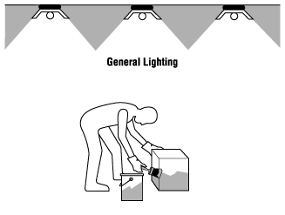
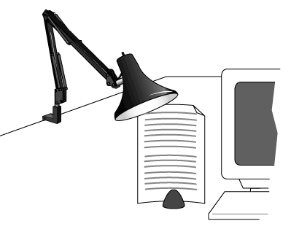
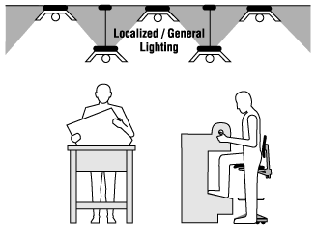
Lighting continued
What are basic types of artificial lighting?
There are three basic types of lighting:
General.
                Localized-general
                Local (or task).

Slide 9
Monitor Placement
Why should we worry about positioning the monitor?
The monitor is an integral part of a computer workstation. When placed in the wrong position it can force the operator to work in a variety of awkward positions. Working with one's chin tilted upwards, and the head and upper body bent forwards or sideways is common wherever the monitor is improperly situated. Such forced working body positions significantly contribute to the operator's discomfort, and can potentially lead to work related musculoskeletal injury (WMSD). Other adverse effects of a poorly located monitor are eye irritation, blurred vision, dry burning eyes and headaches, collectively called eyestrain.
Common complaints among computer operators include discomfort, aches and pains in the neck and shoulder, but also eyestrain. The sheer number of such complaints indicates that the proper position of the monitor has not received enough recognition as an important factor in the arrangement of a computer workstation.

Slide 10
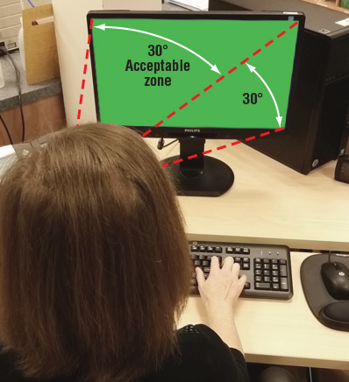
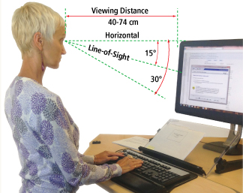
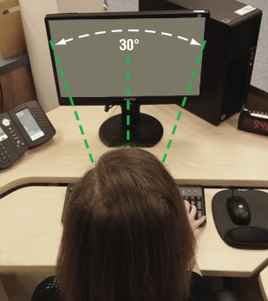
Wh
What factors decide the proper position of the computer monitor?
Postural discomfort and the consequent aches and pains result from the effort to view the monitor when it is set at the wrong place in relation to the operator's position. Two factors come into play: viewing angle and viewing distance. Viewing angle refers to the degree above or below an imaginary horizontal line at the level of the viewer's eyes and the centre of the object being looked at; in case of a computer work it is the centre of the screen. - See Figure 1. Viewing distance refers to the space between the operator's eyes and the screen. - See Figure 1. Clearly these factors are critical for correct placement of a computer monitor. A poor angle leads to postural (neck and shoulders) discomfort, while the wrong distance can contribute to eyestrain.

Slide 11
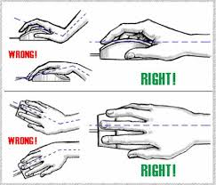
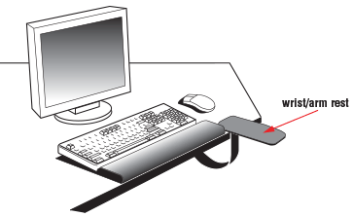
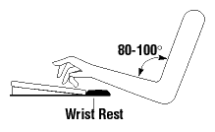
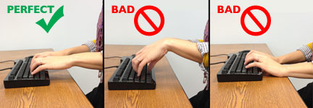
Wrist rest
A "wrist rest" is a device used to support your wrists while typing or when using a computer mouse

Slide 12
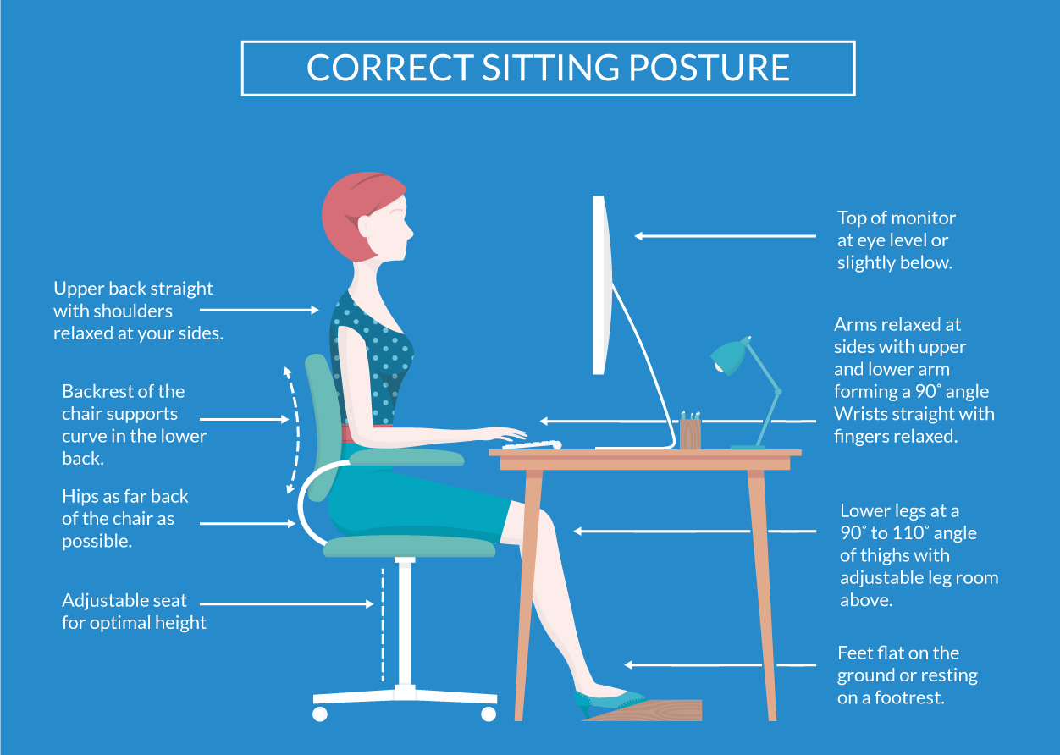
Posture
Sitting in the correct posture can reduce fatigue

