Slide 1
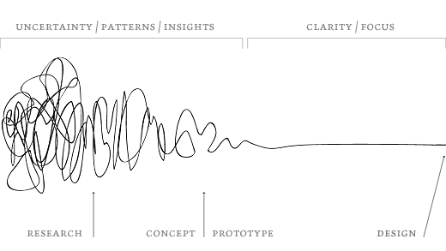
The design process

Slide 2
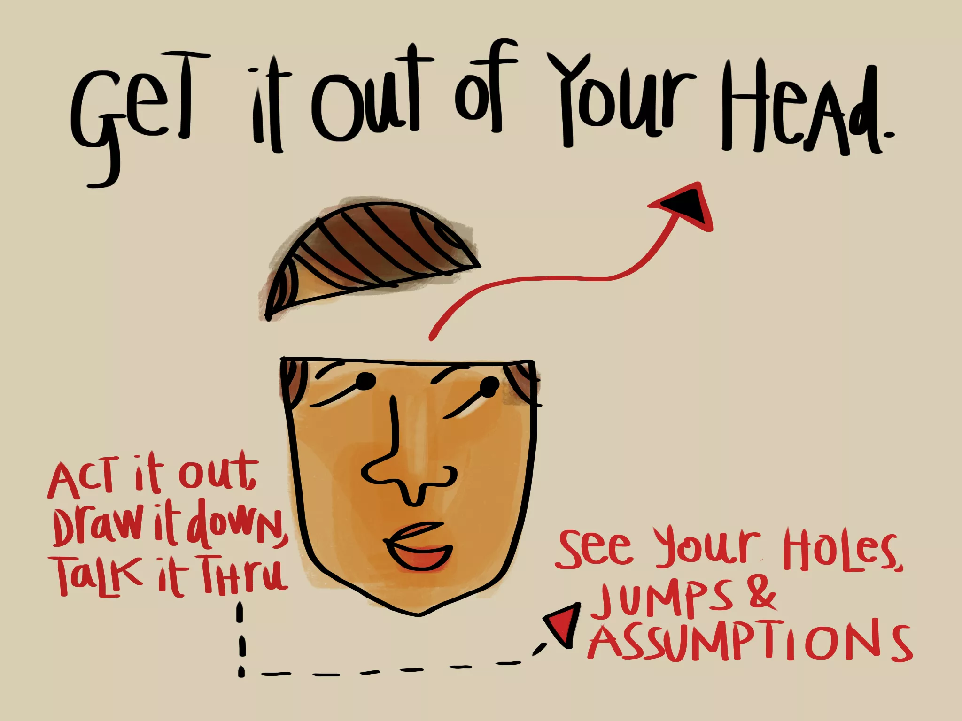
Think about what you want your final product to be. Then work backwards to find your beginnings.
Think of any questions that you may need answered about your product by the teacher

Slide 3
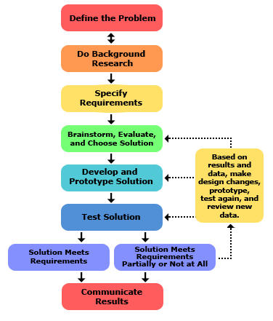
Follow these easy steps to be
Successful in your assignment

Slide 4





Define the problem:
Your assignment
To highlight one of the popular types of social media (Twitter, Facebook, Instagram, Snapchat, Pinterest) and create a how to video how to use the application
Your video has to be 5 min long and has to explain the basic uses of a different applications.
You are also required to look at the different features that the app has to offer
Highlight the dangers that may happen when using the apps

Slide 5
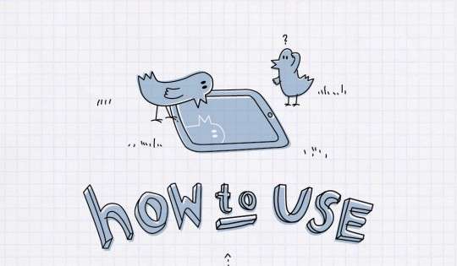
Do background research: download the app
Download the application and open the help menu.
If you download the app for the first time, they may guide you how to use it
Within your groups, use the app to interact with each other.
Explore as many features it has to offer.

Slide 6


Specific requirements: Your video
Remember what is required of you:
To create video highlighting one type of social media

Slide 7


Brainstorming then choosing a solution
Once you have familiarized yourself with the application of your choice, it is then up to your groups how you would like to approach the assignment.
Do you want to be comedic, straight to the point, or a little bit of both.
Once your group has come to a conclusion, start the planning process

Slide 8
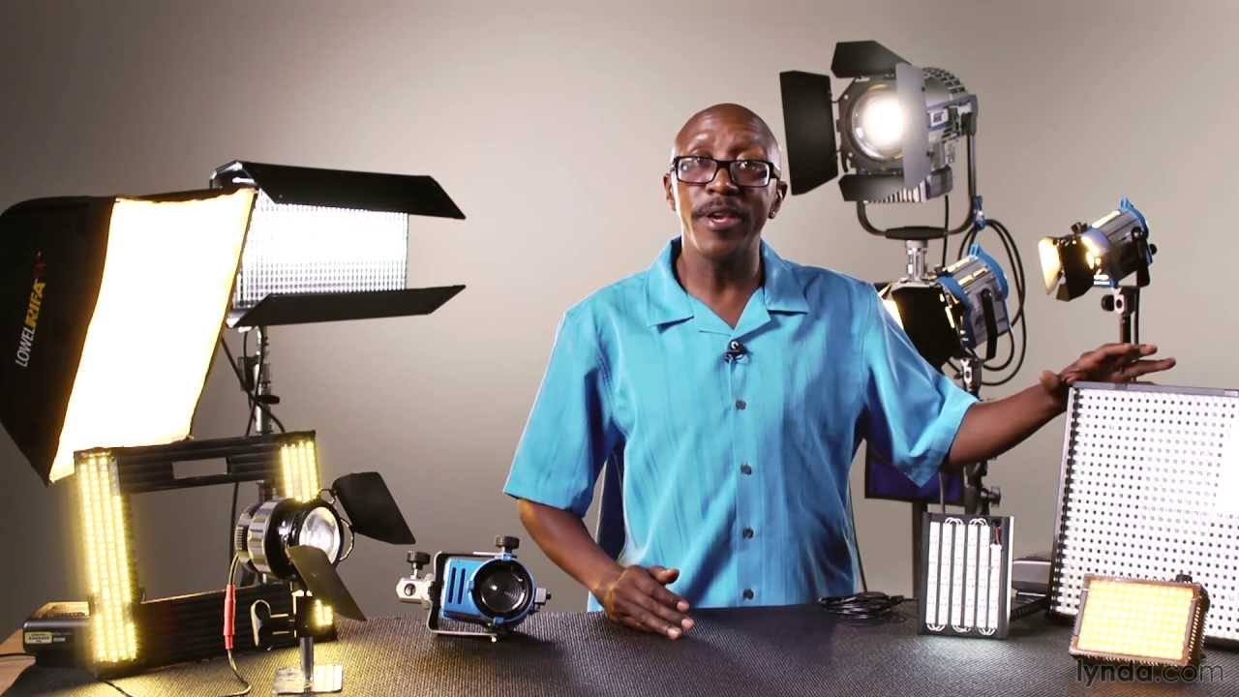
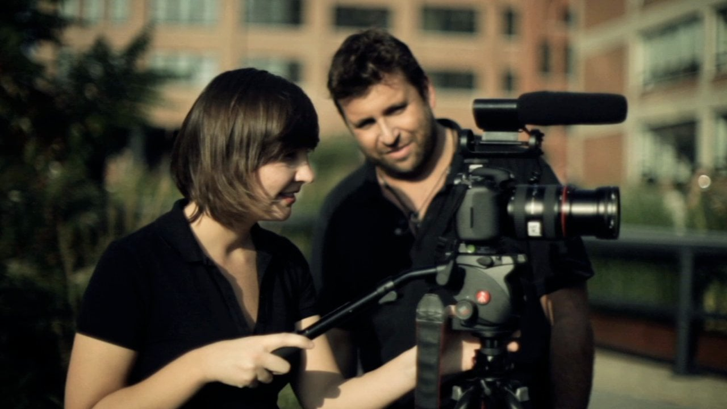
Developing
Start to film the process.
It can be from many different perspectives ( first person, third person etc)
Work with your group members to use the ideas that you all came up with to produce the video.
Remember to properly outline the different ways to use the app.

Slide 9



Test: Take a look at your video
View your video several times to look for opportunities for
improvement.
With the editing process, be prepared to re shoot scenes that you may\
want to change

Slide 10


Check to see all criteria is met
Have you outlines all the ‘how to’ options?
Are the dangers of the social media easily visible?
Is it clear that all group members are participating?
Is your social media well displayed?

Slide 11
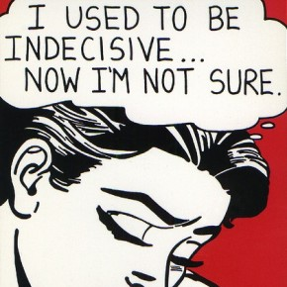


Solution
If you feel that you have met the requirements, hand in the project to the teacher for evaluation.
                OR
                If you feel that your video needs a changer or improvement, feel free to take the time to make your video to the best of your liking.

